Slide 1

Cisco Packet Tracer
Jonny Clark
Owen Richardson
Kais Mustafa Kanaan
Calley Smith
Ian Pike

Slide 2
MINS 545
Advanced Distributed Systems Management
Issues in large scale distributed systems
Discussions of various Internet-oriented developments
Hands on LAN configuration

Slide 3
Cisco Packet Tracer
Cisco Packet Tracer is a powerful network simulation program.

Slide 4
Cisco Packet Tracer
The Packet Tracer software is available free of charge ONLY to Networking Academy instructors, students, alumni, and administrators that are registered Academy Connection users.
To Download Packet Tracer:
Log in to Academy Connection (you must be a registered Networking Academy student, alumni, instructor, or administrator)
After logging into Academy Connection, select the Packet Tracer graphic to download
Packet Tracer

Slide 5
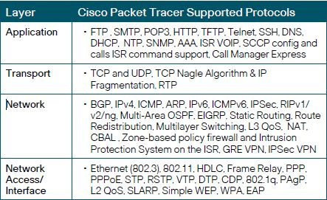
Cisco Packet Tracer

Slide 6
Cisco Packet Tracer
Live Demo

Slide 7
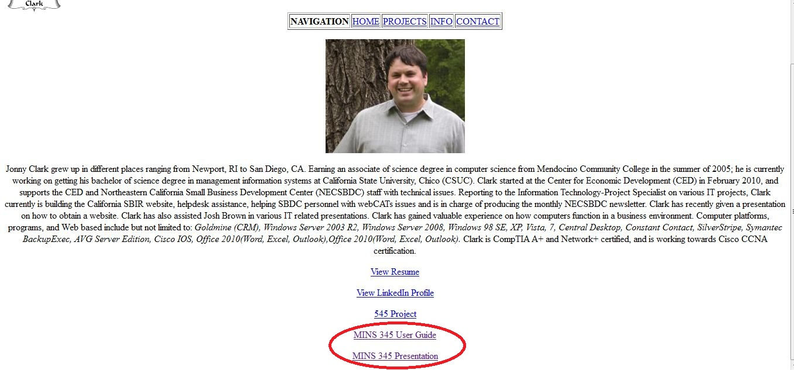
Cisco Packet Tracer
www.derfsandbox.com

Slide 8
Cisco Packet Tracer
Questions?

